Slide 1
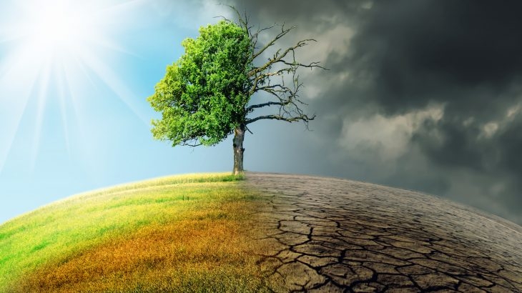
Climate Change
Effects on our life

Slide 2
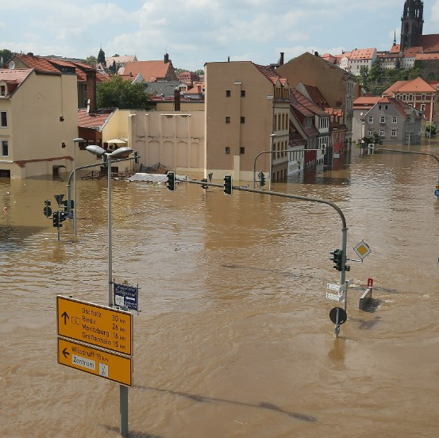
Effects of Climate Change in Germany
In some regions there are problems with flooding.
Due to problems with water, the crops are not growing as well as normally and the food we buy in supermarket are more expensive than before.
In bigger cities there is also problem with air pollution.

Slide 3
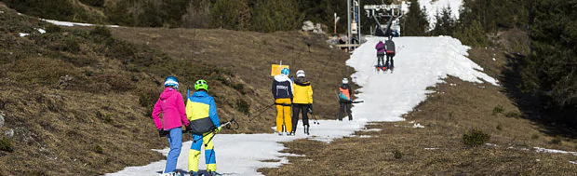
Effects of Climate Change in Sweden
In bigger cities we have a bit of a problem with air pollution.
We are cutting down our trees at alarmingly fast rate, this might be a problem in the future.
Up here in the north, where we live, we have started to notice that the weather is changing. For instance, we have an unusually small amount of snow during the winters.
The lack of snow affects both the inhabitants and the tourism, because our ski resorts can't open and keep up the business if there is no snow.

